Slide 1
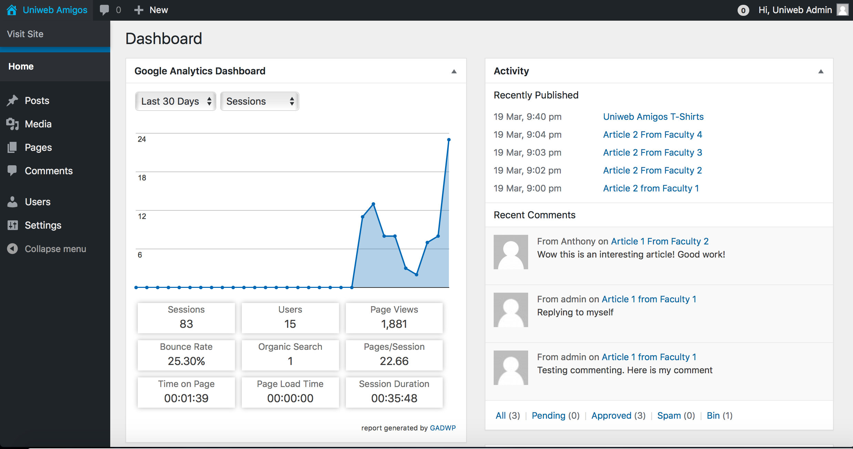
Notes:
When you first login as an admin, you get presented with the dashboard, this allows you to see everything that has go on with either the statistics of the website itself or users comments

Slide 2
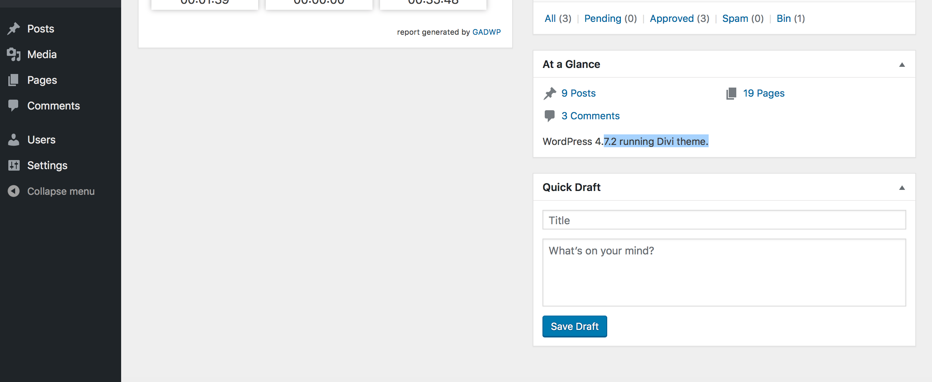
Notes:
Continuation of the admin’s dashboard, we have a “At a Glance” feature, which allows the admin to see exactly how many posts, pages and comments have been made

Slide 3
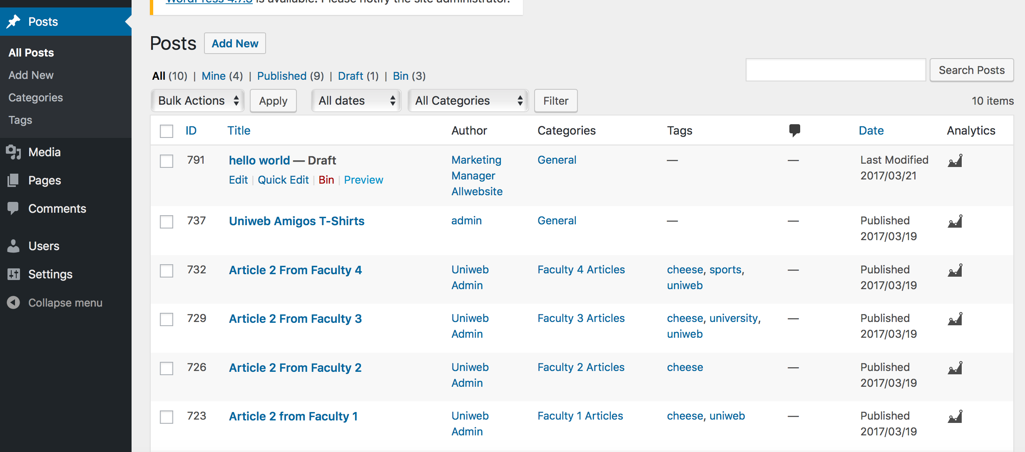
Notes:
This page allows the admin to see the posts made and can either edit, delete them for either spam, explicit language and etc

Slide 4
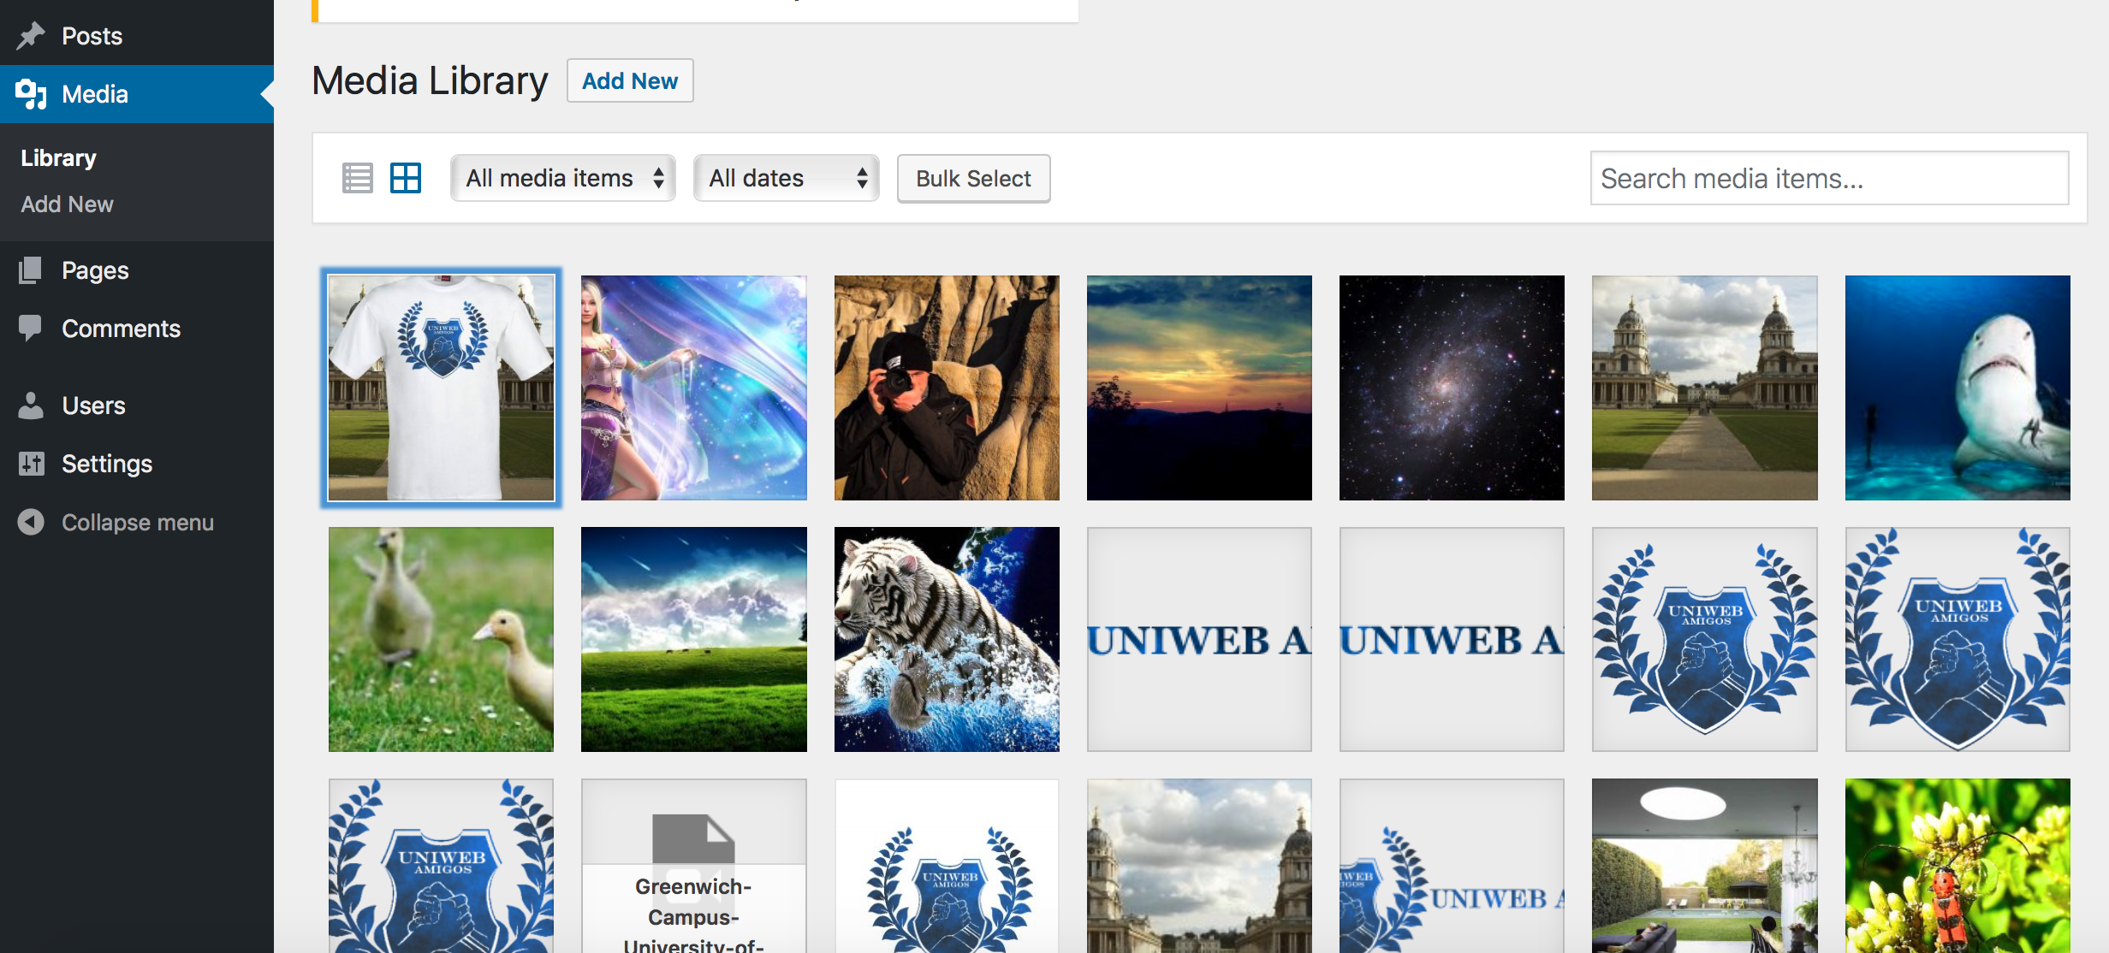
Notes:
This page shows all of the images that are uploaded to the site, either by admin and higher or by other users like students, contributors.

Slide 5
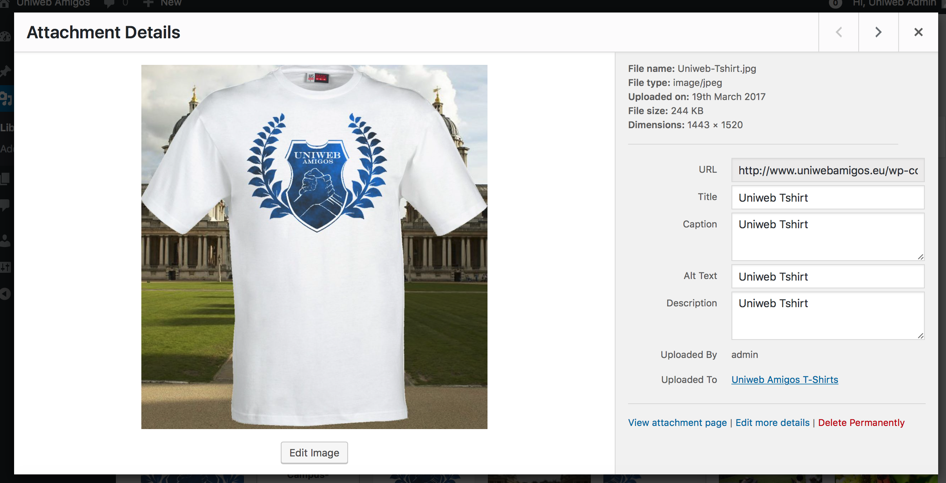
Notes:
Example of the image system, displaying information about image itself and the title, caption it was given when uploaded, and who uploaded it
Also the admin or higher can edit things or just delete the image depending on the nature of it.

Slide 6
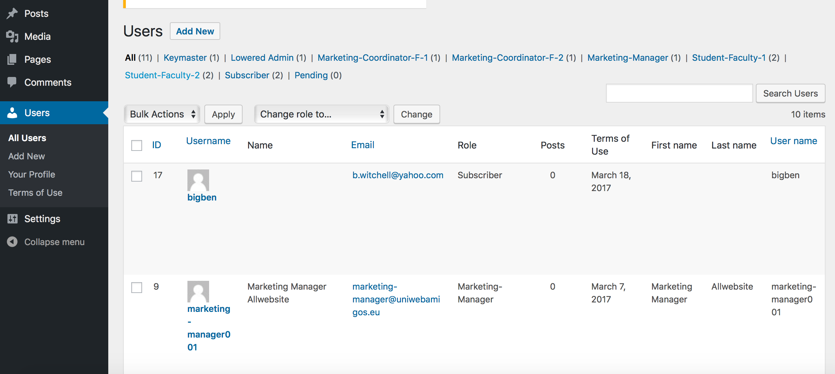
Notes:
This page shows the admins and higher, any new users, their role and information about them

Slide 7
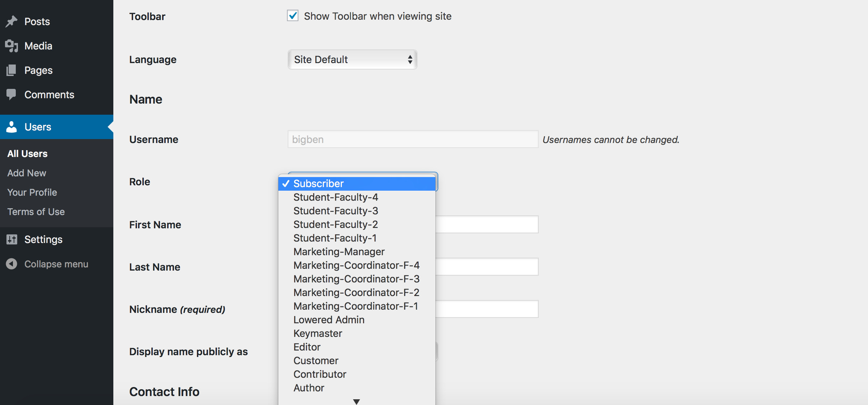
Notes:
In this shot, the admin can change the role of the new subscriber “bigben” to something else if necessary
This is a way of eliminating spam accounts because they cant really do much

Slide 8
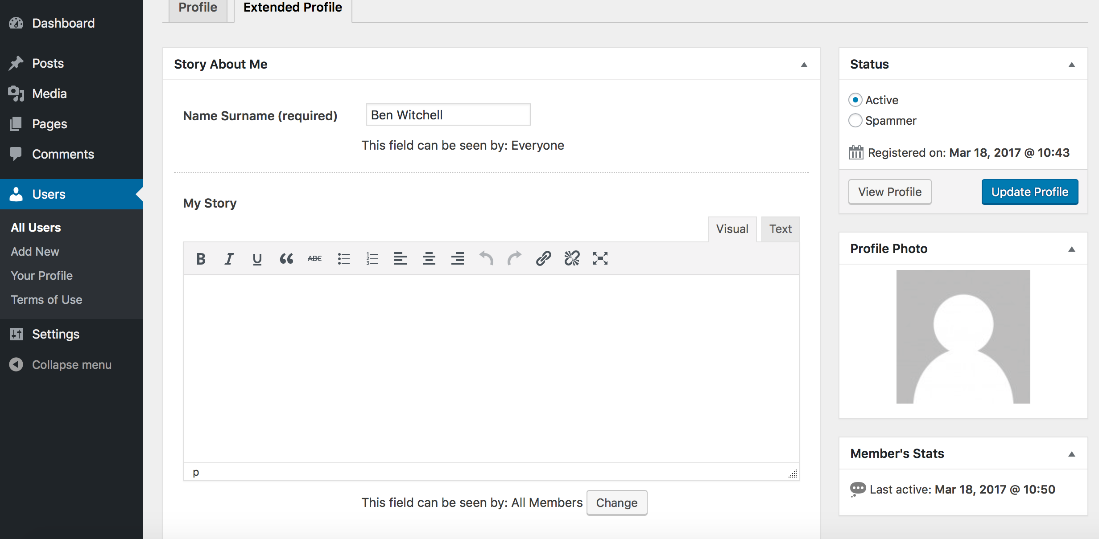
Notes:
We can change things on bigben’s account mainly if he puts any explicit things on there himself like in his bio or in this profile pic

Slide 9
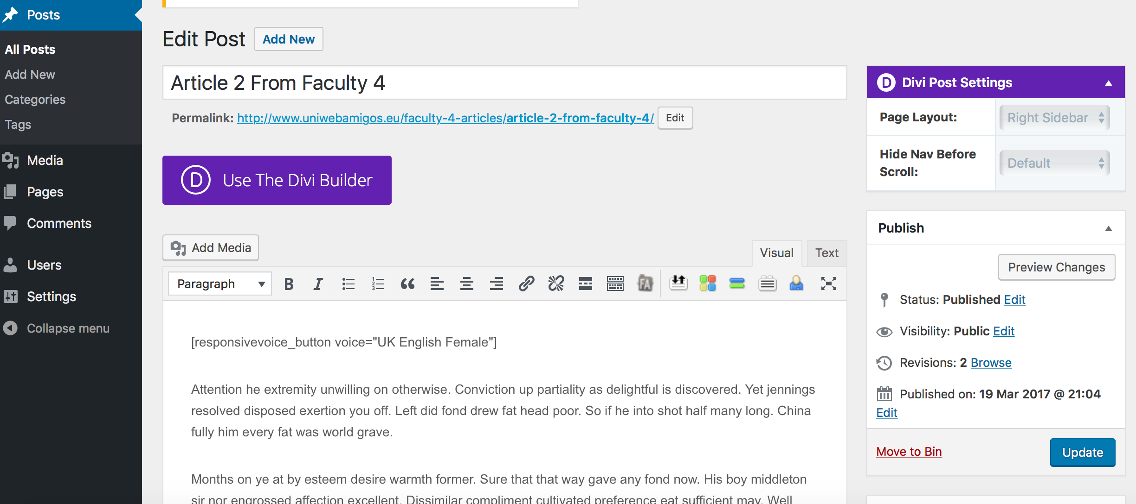
Notes:
The post system allows us to check posts and freely change them if needed, like certain words,
Can even change if this post can be viewed publicly or not,

